Slide 1
Surgical Emergencies in Pregnancy
Almir Kalajdzic, PGY-2

Slide 2
Financial disclosures

Slide 3
Case
Patient is a 27 year old G1P0 female at 34 weeks gestation who presents with complaint of superior RLQ abdominal pain and vomiting. Her vitals are T- 100.6 , BP- 127/83, HR- 114, 94% O2 RA. Physical exam + RLQ tenderness, no rebound. Labs- WBC 17.5, lactate normal, hgb unchanged from baseline. LFT/Bili/platelets normal
Differentials ?
Acute appendicitis
Cholecystitis
Ovarian torsion
Hemorrhagic cysts
SBO
Ovarian Tumor
Colitis
malingering

Slide 4
Case
Patient is a 27 year old G1P0 female at 34 weeks gestation who presents with complaint of RLQ abdominal pain and vomiting. Her vitals are T- 100.6 , BP- 127/83, HR- 114, 94% O2 RA. Physical exam + RLQ tenderness, no rebound. Labs- WBC 17.5, lactate normal, hgb unchanged from baseline
What to do from here ? What interventions ?

Slide 5
Case
Patient is a 27 year old G1P0 female at 34 weeks gestation who presents with complaint of RLQ abdominal pain and vomiting. Her vitals are T- 100.6 , BP- 127/83, HR- 114, 94% O2 RA. Physical exam + RLQ tenderness, no rebound. Labs- WBC 17.5, lactate normal, hgb unchanged from baseline
First always start with continuous fetal heart monitoring
No NSAIDs for pain
Opiates are okay to use
Reglan, zofran for nausea
IV Fluids
Penicillins/Clinda/Cephalosporins okay if appropriate

Slide 6
Imaging in pregnancy
Germ Theory
Any radiation exposure in pregnancy is dangerous and will cause mutant childrens

Slide 7
Imaging in pregnancy
Germ Theory
ACOG
Radiation of less than 5 rads (50 mSv) not associated with increased risk of fetal abnormalities.
If indicated, radiation concern should not impact necessity for definitive diagnosis
If alternatives readily available, like MRI and US, try and utilize if appropriate

Slide 8
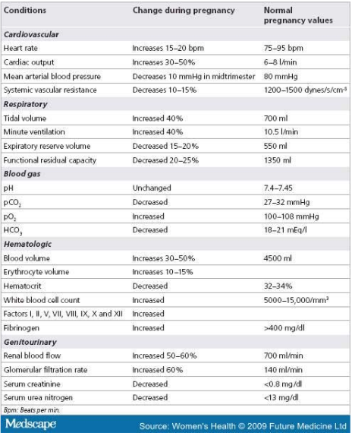

Slide 9
Changes in Pregnancy
Germ Theory
• Plasma volume increases by 45%
• Red blood cell mass increases by 20-30%
• Relative leukocytosis (12,00-14,000)
• Hypercoagulable
• Result– Significant blood volume loss may occur before tachycardia and hypotension signal pathology, Hypercoagulability increased risk for DVT and PE

Slide 10
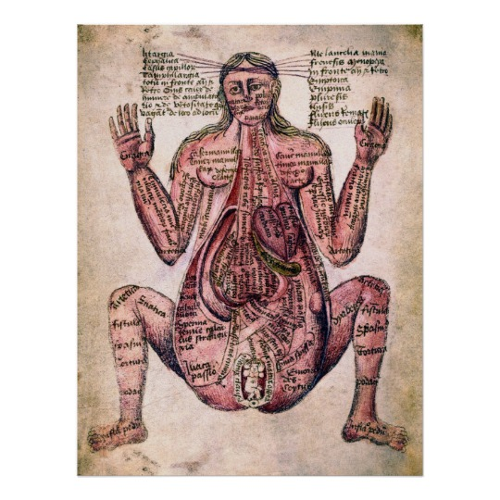
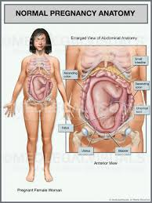
Changes in Pregnancy
Germ Theory
Decreased GI motility
Decreased transit time
Constipation
Cholestasis
Hydroureter
Respiratory alkalosis
Increased oxygen consumption
Notes:
In pregnancy, especially in the later stages, the intestines get pushed around, which causes variety of issues, including decreased GI motility, constipation, and it can cause the appendix to go on an adventure, migrating around much more readily, even up to RUQ

Slide 11
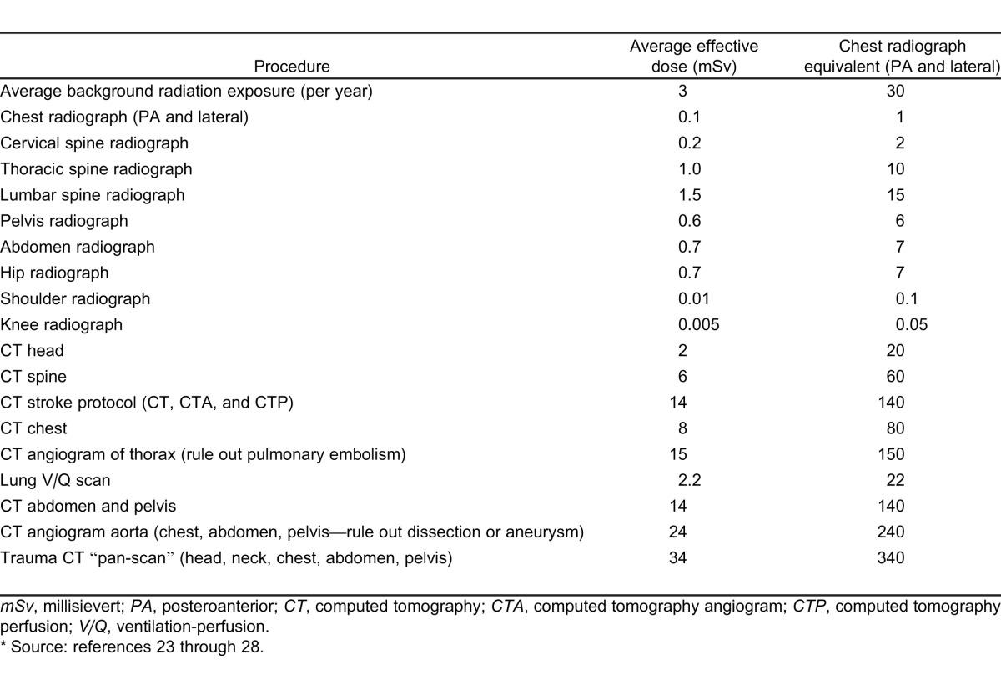
Imaging in pregnancy
Germ Theory
ACOG
Radiation of less than 5 rads (50 mSv) not associated with increased risk of fetal abnormalities.
If indicated, radiation concern should not impact necessity for definitive diagnosis
If alternatives readily available, like MRI and US, try and utilize if appropriate
Notes:
As you can see, even a full pan-scan for trauma is below the threshold of 50mSv to increase risk of fetal abnormalities. ( Now, yearly recommendation for radiation exposure is advised to be below 30mSv over a lifetime, but that is a different story)

Slide 12
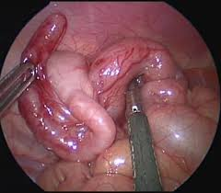
Appendicitis in Pregnancy
1/500- 1/1000 pregnant patients
Difficult to diagnose, leads to increased morbidity
Pregnancy overall seems protective based on some studies
Lowest incidence in third trimester
U/S first imaging modality, 80-85% sensitivity
C/S OBGYN for further recs if inconclusive
Helical CT, if available, very low radiation
CT Imaging if not
Most common surgical emergency in pregnancy

Slide 13
Cholecystitis in pregnancy
1/1000 pregnancies
Use U/S for diagnosis along with labs
Treatment
Conservative management if possible
IV fluids
Antibiotics
If necessary, laparoscopy is safest in 2nd trimester d/t enlarging uterus

Slide 14
SBO in Pregnancy
1/2000-3000 Incidence
Adhesions most common cause (60-65%)
Volvulus 25%
Complex surgical problem
Significant fetal risk
9% stillbirth rate in one review (92 pregnancies)
Increased risk of preterm delivery and Caesarean

Slide 15
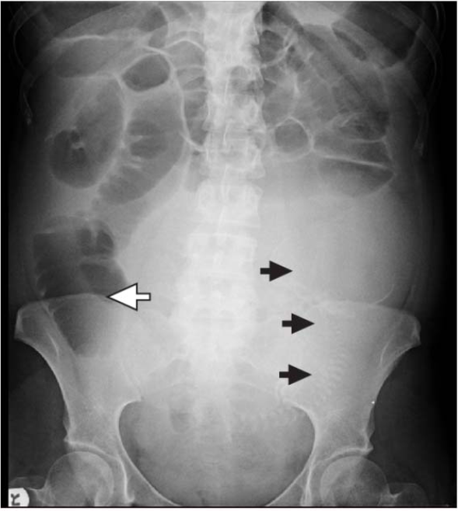
SBO
Notes:
Here is image of SBO, you can see the positive arrow sign here pointing to likely point of blockage, with black arrows pointing to fetus head and spine

Slide 16
Case
38 year old female G2P1 at 14 weeks gestation presents with complaint of pelvic pain and vaginal bleeding. She says she has noticed some clots passing, and she saved them and brought them to show you. Vitals : T 98.6, HR 105, BP 114/70, RR 20.
Threatened abortion
Incomplete abortion
Complete abortion
Vasa previa
Differentials ?
Notes:
Here is image of SBO, you can see the positive arrow sign here pointing to likely point of blockage, with black arrows pointing to fetus head and spine

Slide 17
Spontaneous Abortion
20-30% of all pregnant women have spotting/bleeding in first trimester, 50% of which will miscarry
If fetal heart tones present, spontaneous abortion risk drops to 2-3%
>50% d/t fetal chromosomal abnormalities
90% of couples who have a spontaneous abortion are able to have normal child in later pregnancies
May occur up to 20weeks gestation
Always r/o ectopic pregnacy
Notes:
Here is image of SBO, you can see the positive arrow sign here pointing to likely point of blockage, with black arrows pointing to fetus head and spine

Slide 18
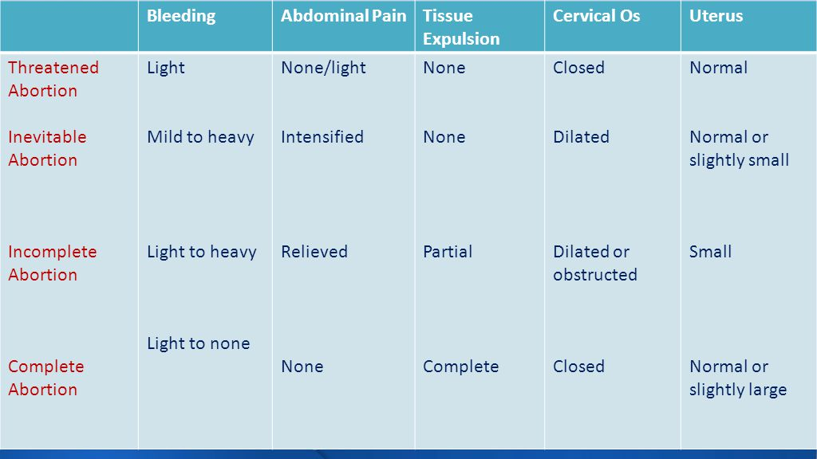
Types of abortions
Notes:
Here is image of SBO, you can see the positive arrow sign here pointing to likely point of blockage, with black arrows pointing to fetus head and spine

Slide 19
Complete abortion
Follow up with OB outpatient, supportive care
Return precautions for hypotension, foul smelling d/c
Repeat hcg in 48-72 hours, no heavy exertion
Incomplete Abortion
c/s OB, especially with severe bleeding, non-diagnostic US
May need D&C
Medical management per OBGYN
Bleeding may continue fo 7-10 days

Slide 20
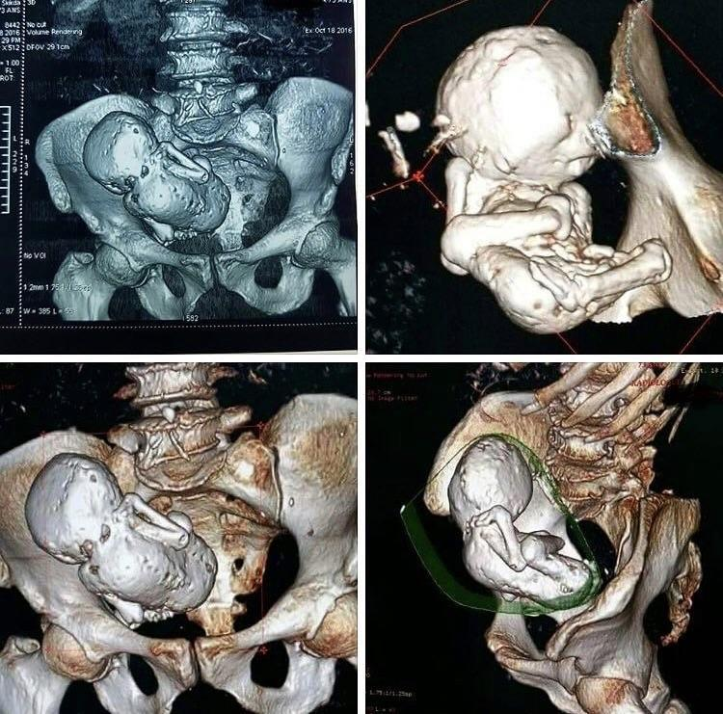
Missed abortion
-Fetus deceased but did not pass
- Known as intrauterine fetal demise ( IUFD)

Slide 21
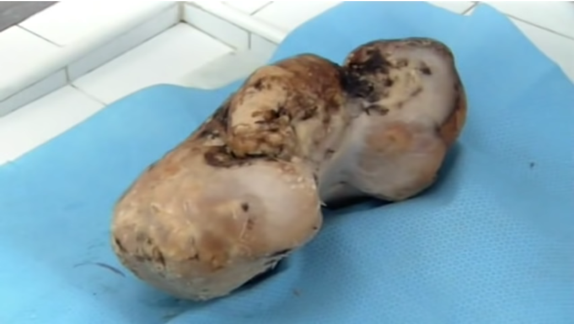
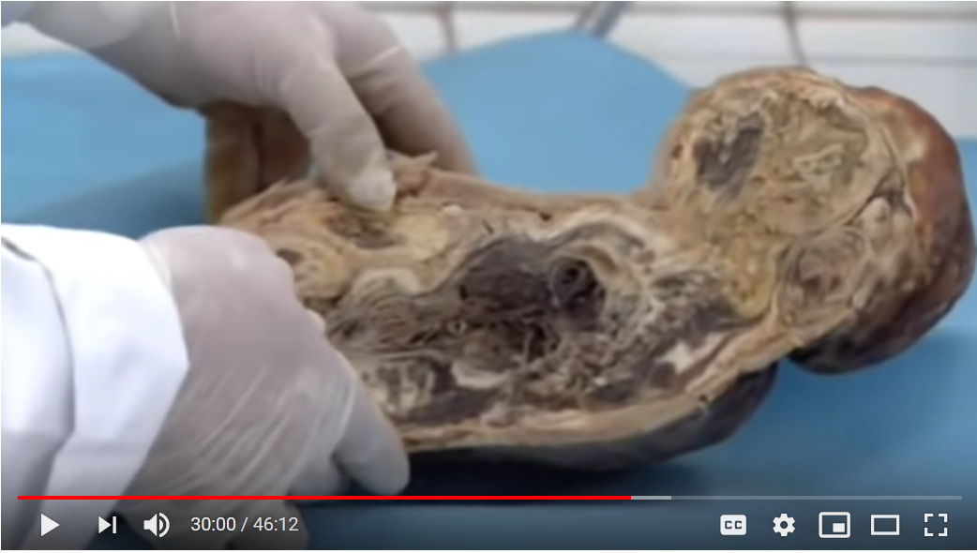
Notes:
Lithopedian- 46 year old calcified fetus from a missed abortion in a woman in morocco,

Slide 22
Septic Abortion
Retained products / endometritis post D&C
More common with unsterile practices
Bleeding, foul purulent discharge, pain, fever and nausea
Boggy tender and large uterus
Admit, broad sepctrum abx (amp/gent/clinda), repeat D&C
Complications may include rupture, abscess formation and potential need for hysterectomy

Slide 23
